Slide 1

Imad5112 Dr Rodney Practicum Exam St10447706

Slide 2
M Y teMP APP

Slide 3
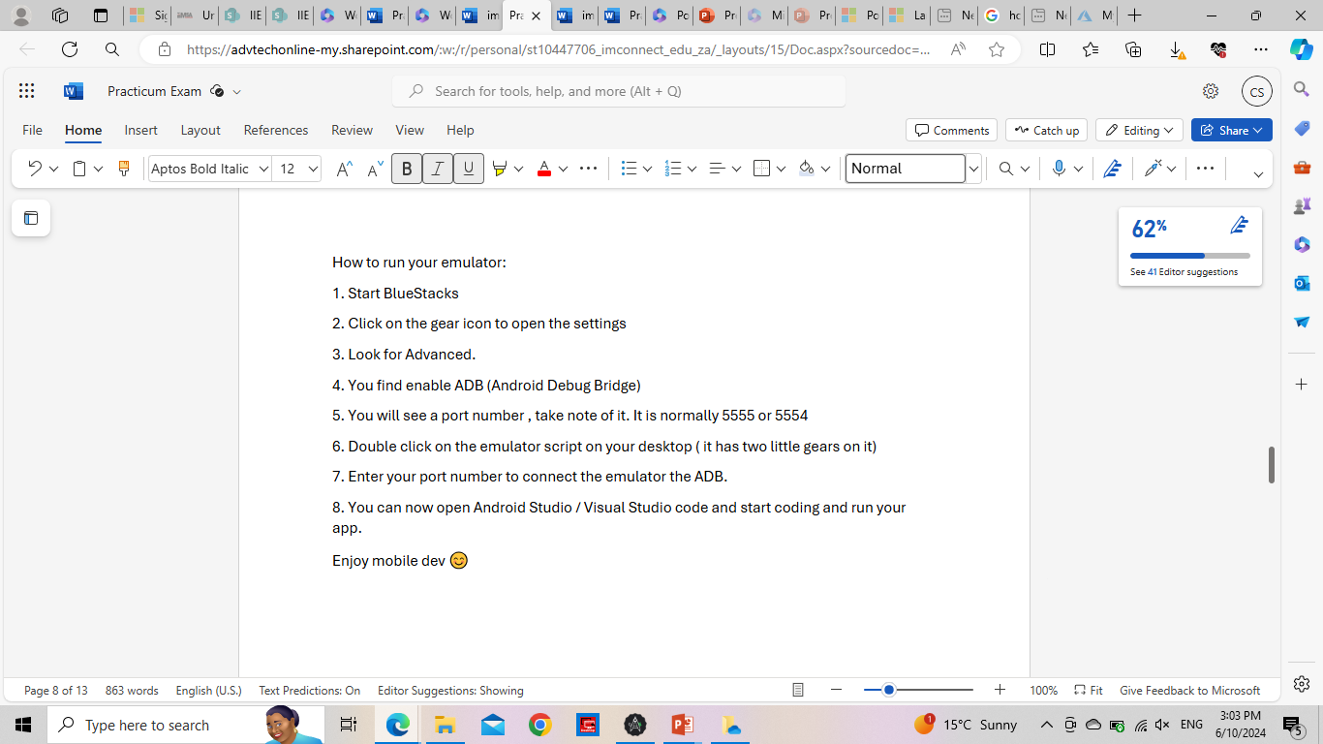
Read me File

Slide 4
Purpose:
THE FOLLOWING APP IS FOR THE SOLE PURPOSE OF ESTABLISHING THE TEMPERATURE FOR DAYS MONDAY TO SUNDAY , THEN CALCULATING ITS AVERAGE TEMPERATURE FOR EACH DAY

Slide 5

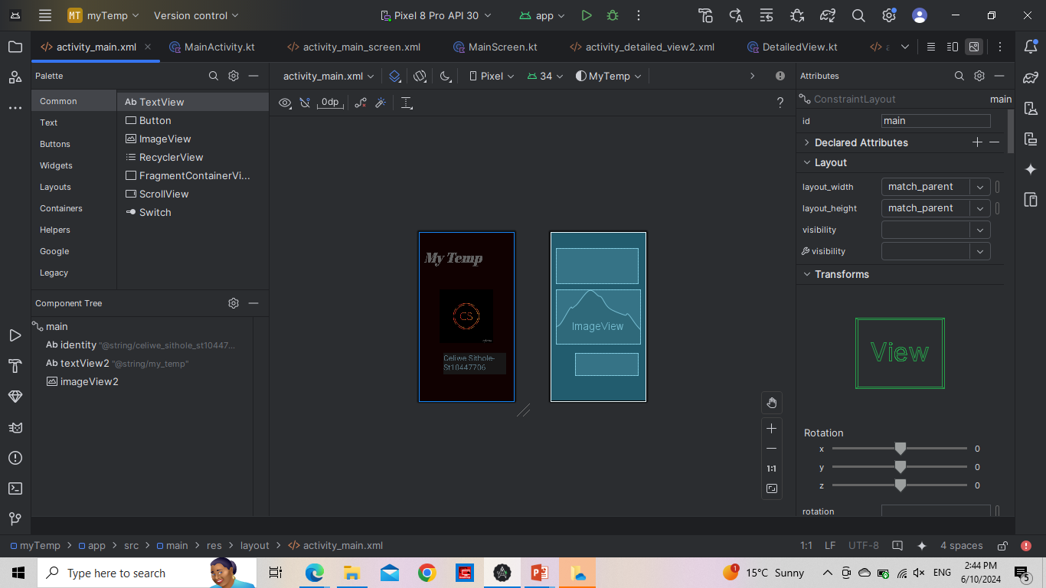
This is My First screen:

Slide 6
Splash Screen
My Splash screen consisits of my name, student number and logo. As well as the name of my app.
It takes 5 seconds to navigate from the splash screen to my Second/ Main screen.

Slide 7
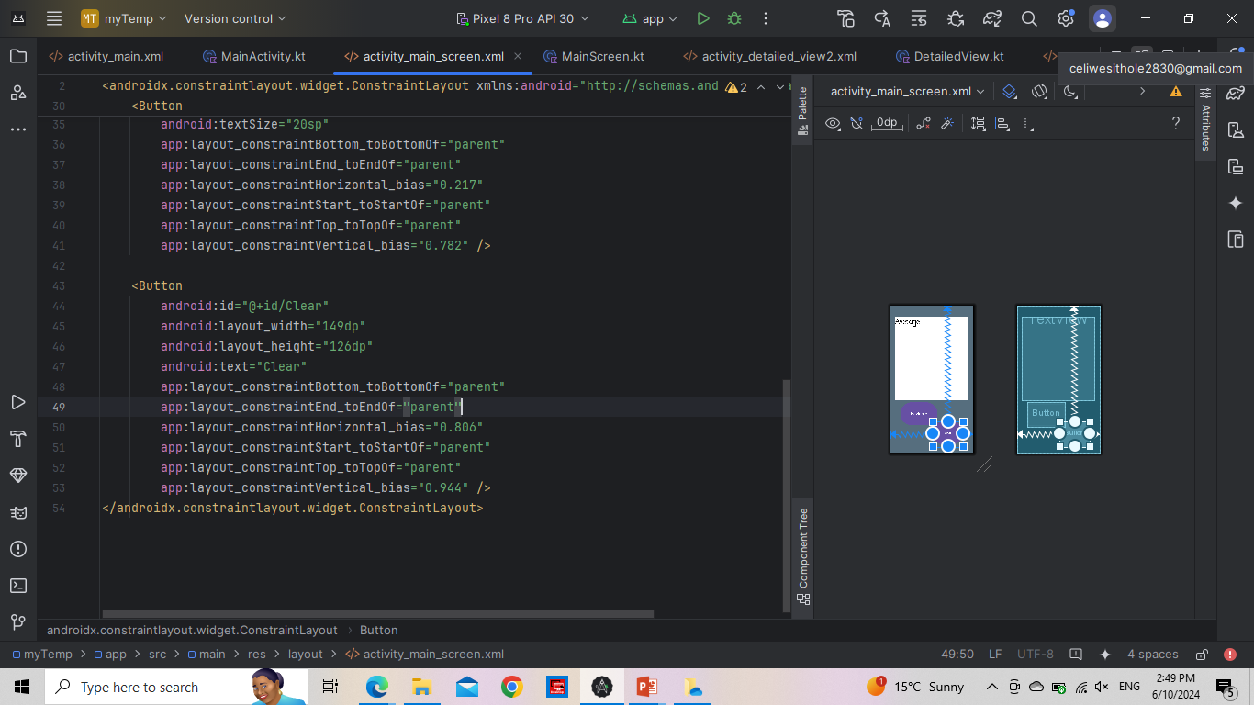
Main screen. in My maIN scREEN , YOU WILL FIND A PARALLEL ARRAY THAT CONSISTS OF AVERAGE TEMPERATURE WHICH WILL BE DISPLAYED IN MY textview, a clear button which will erase information and a navigate button to go to the next screen when clicked

Slide 8
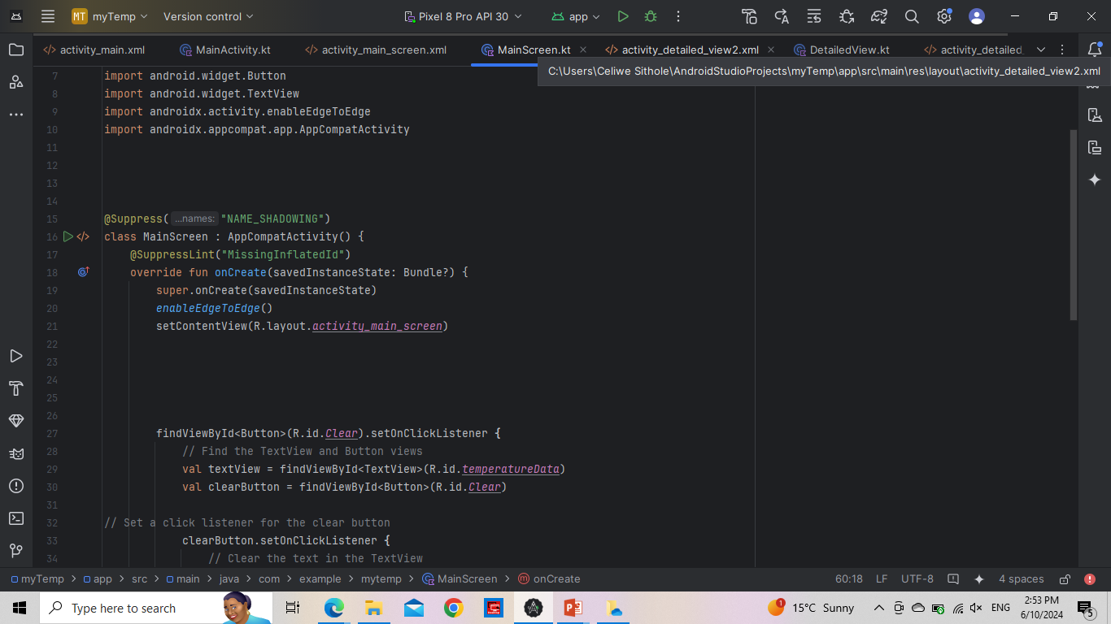
Main Activity

Slide 9
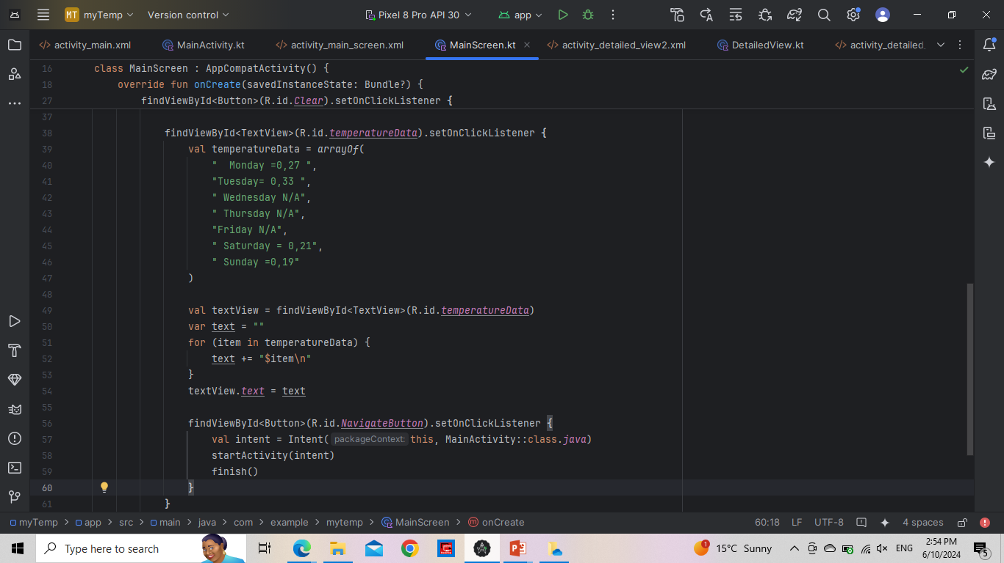

Slide 10
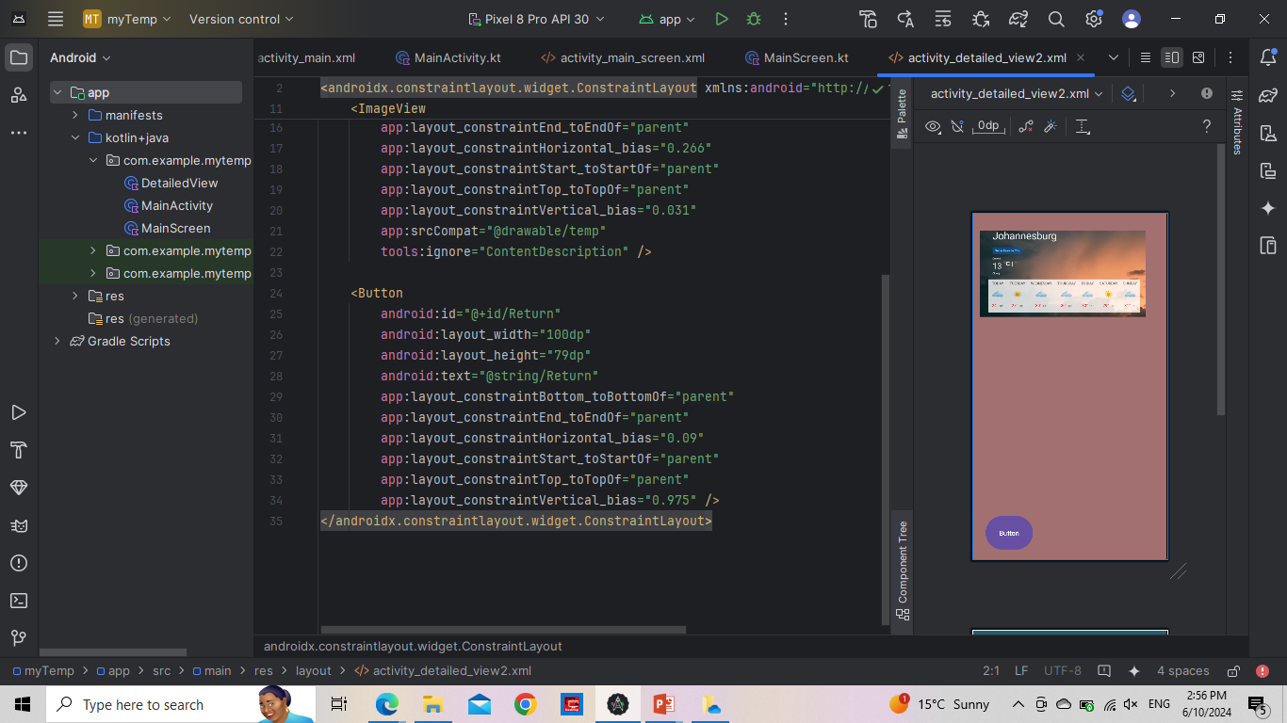
Detailed View Screen

Slide 12
What is anxiety?
Excessive worrying or panic that may feel suffocating.
Sound familiar huh?
Fear not, because although some people view it as a personal weakness it is a real feeling that causes one to feel uncomfortable in their own skin, making one feel claustrophobic in their own body
GAD- Generalized Anxiety disorder.
EFFECTS OF ANXIETY:
* Increased heart rate . Tense muscles. Insomnia
*Headaches. Dementia .
It can have a detrimental effect on your health.
Eg elavating cortisol and adrenalin levels and creates a space for Depression.
MANAGING STRESS AND ANXIETY IS CRUCIAL FOR MAINTAINING A BALANCED LIFE.

Slide 13
What is anxiety?
Excessive worrying or panic that may feel suffocating.
Sound familiar huh?
Fear not, because although some people view it as a personal weakness it is a real feeling that causes one to feel uncomfortable in their own skin, making one feel claustrophobic in their own body
GAD- Generalized Anxiety disorder.
EFFECTS OF ANXIETY:
* Increased heart rate . Tense muscles. Insomnia
*Headaches. Dementia .
It can have a detrimental effect on your health.
Eg elavating cortisol and adrenalin levels and creates a space for Depression.
MANAGING STRESS AND ANXIETY IS CRUCIAL FOR MAINTAINING A BALANCED LIFE.

Slide 14
What is anxiety?
Excessive worrying or panic that may feel suffocating.
Sound familiar huh?
Fear not, because although some people view it as a personal weakness it is a real feeling that causes one to feel uncomfortable in their own skin, making one feel claustrophobic in their own body
GAD- Generalized Anxiety disorder.
EFFECTS OF ANXIETY:
* Increased heart rate . Tense muscles. Insomnia
*Headaches. Dementia .
It can have a detrimental effect on your health.
Eg elavating cortisol and adrenalin levels and creates a space for Depression.
MANAGING STRESS AND ANXIETY IS CRUCIAL FOR MAINTAINING A BALANCED LIFE.

Slide 15
The end!

Slide 16
*Discuss Stress And Anxiety
*Discuss Strategies To Manage Stress
And Anxiety:
.Before Exams
.During Exams
.After Exams

Slide 17
*Discuss Stress And Anxiety
*Discuss Strategies To Manage Stress
And Anxiety:
.Before Exams
.During Exams
.After Exams

